Slide 1

AWS SQS , MQ
Overview of AWS SQS and Amazon MQ

Slide 2

01
AWS SQS Overview

Slide 3
Features and Benefits
AWS SQS is a fully managed message queuing service offering high scalability, durability, and simplicity, enabling decoupling of microservices and distributed systems.

Slide 4

Use Cases in Cloud Architectures
SQS is widely used for asynchronous communication, workload buffering, event-driven architectures, and improving fault tolerance between distributed components.

Slide 5
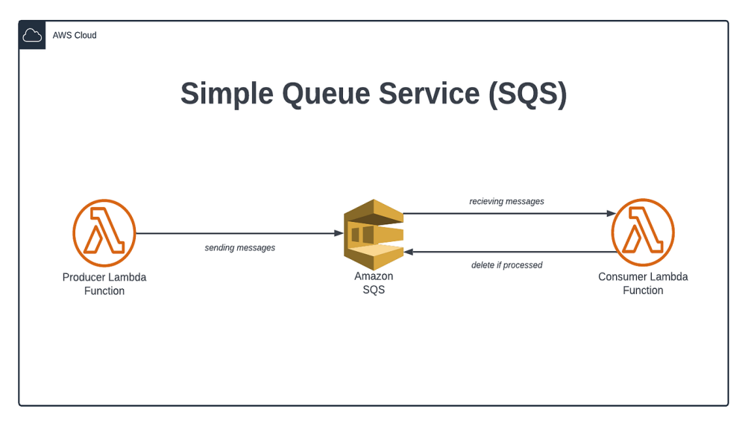
Integration and Security
AWS SQS integrates seamlessly with other AWS services like Lambda and EC2. It supports encryption, access policies, and VPC endpoints to ensure message security and compliance.

Slide 6

02
Amazon MQ Overview

Slide 7
Features and Benefits
Amazon MQ is a managed message broker service for Apache ActiveMQ and RabbitMQ that simplifies setup, maintenance, and scalability for traditional messaging applications.

Slide 8
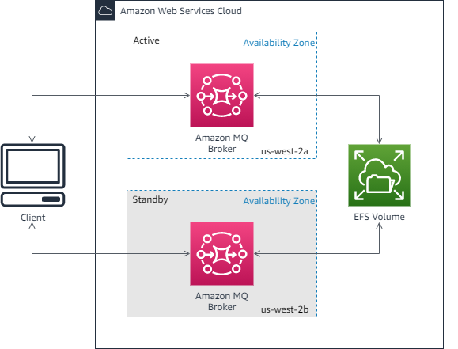
Supported Protocols and Brokers
Amazon MQ supports industry standards like JMS, AMQP, MQTT, and STOMP, and brokers such as ActiveMQ and RabbitMQ, ensuring compatibility with existing applications.

Slide 9

Use Cases and Integration
Common use cases include migrating legacy messaging systems, enabling hybrid architectures, and supporting reliable messaging in microservices with deep integration into AWS.

Slide 10
Conclusions
AWS SQS is ideal for scalable, serverless messaging, while Amazon MQ suits traditional protocols. Both enable robust, secure, and manageable messaging solutions for modern cloud applications.

